Slide 1

PREDICTIVE HEALTHCARE ANALYSIS
GROUP 9
Notes:
Photo by rawpixel on Unsplash

Slide 2
BACKGROUND
The US has been the largest spender on healthcare compared to other nations, devoting almost twice as much of its economy to its healthcare as the average OECD country.
The Paradox
The US also has lower life expectancy and higher avoidable mortality rates than several of other middle-and-high-income countries.
Notes:
rodrigo

Slide 3
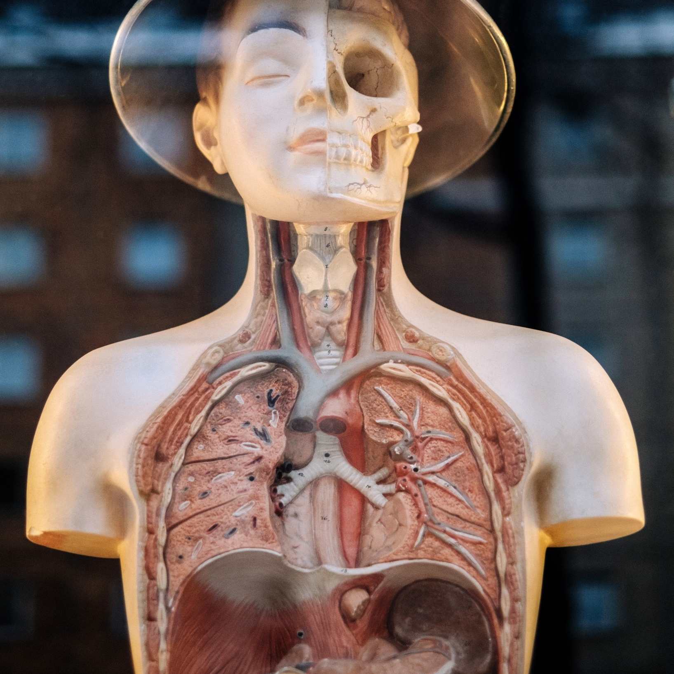
BUSINESS PROBLEM
How can healthcare providers use predictive healthcare analytics to take proactive measures to prevent the onset of illnesses and premature death and improve health outcomes in the long-run?
Notes:
Photo by Samuel Zeller on Unsplash

Slide 4


TUVA/Syntegra Project
Datasets
Synthetic datasets from real patient records to facilitate research and analysis while preserving privacy and data confidentiality.
1,000 simulated patients (in all 50 states) with disease information, clinical visits, outcomes and insurance claims.
Allows researchers to identify key health trends and stimulate treatments before they are used on patients in the real world.
Uses machine learning, real Electronic Health Records (EHR) and insurance claims records to create patient data.
8 subsets, from the original dataset, were used from the primary dataset that are listed below:
Allergy
Condition
Coverage
Encounter
Medical Claim
Medication
Patient
Vital Sign
DATA DETAILS AND
DATA SOURCES

Slide 5
SCHEMA DICTIONARY
TABLE | DESCRIPTION
patient | Personal and demographic information about patients (one record per patient)
coverage | Insurance coverage information (one record per insurance coverage period)
encounter | Visit level information for all different encounter types (one record per visit)
condition | Information about complaints, problems, admit diagnosis and discharge diagnosis
medication | Information about medication requests, administrations, and prescriptions
allergy | Information about patient allergies, their status and severity
vital_sign | Information about vital signs (e.g., heart rate, pulse ox, systolic/diagnostic blood pressure, et cetera)
medical_claim | Line-level claims data, including revenue and HCPCS codes
Notes:
rodrigo

Slide 6

WRANGLING AND PRE-PROCESSING
STEP 1
STEP 2
STEP 3
STEP 4
STEP 5
STEP 6
Age Calculation
Claim Duration
Encounter Duration
Prescription Procurement Duration
Creation of dummy variables
Master Dataset
Subtracted today’s date from patient’s birthdate
Subtracted Claim Start Date from Claim End Date
Subtracted Encounter Start Date from Encounter End Date
Subtracted date the medication was requested from the date the request was filled
Race, gender, request status, doses, diagnosis, claim type, HCPCS modifier 4 codes, LOINCs
Created subsets with relevant variables and merged all the datasets using left join, keeping Patient_ID as unique identifier
Challenges
Patient IDs were not similar across all eight tables, hence while merging and preprocessing only 125 records remained. As a result, lots of duplicate columns were generated while merging.
Notes:
MERGED DATASET 67 – CLEAN 44 COLS - shiv

Slide 7
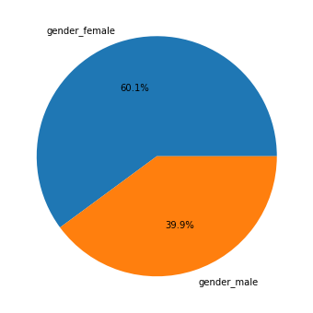
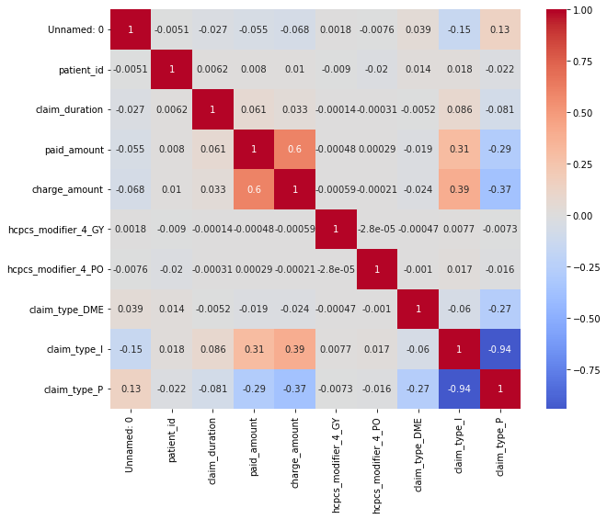
WRANGLED DATASET EDA
Patient Gender Distribution
Correlation Matrix of Variables
Wrangled Dataset EDA
Notes:
shiv

Slide 8
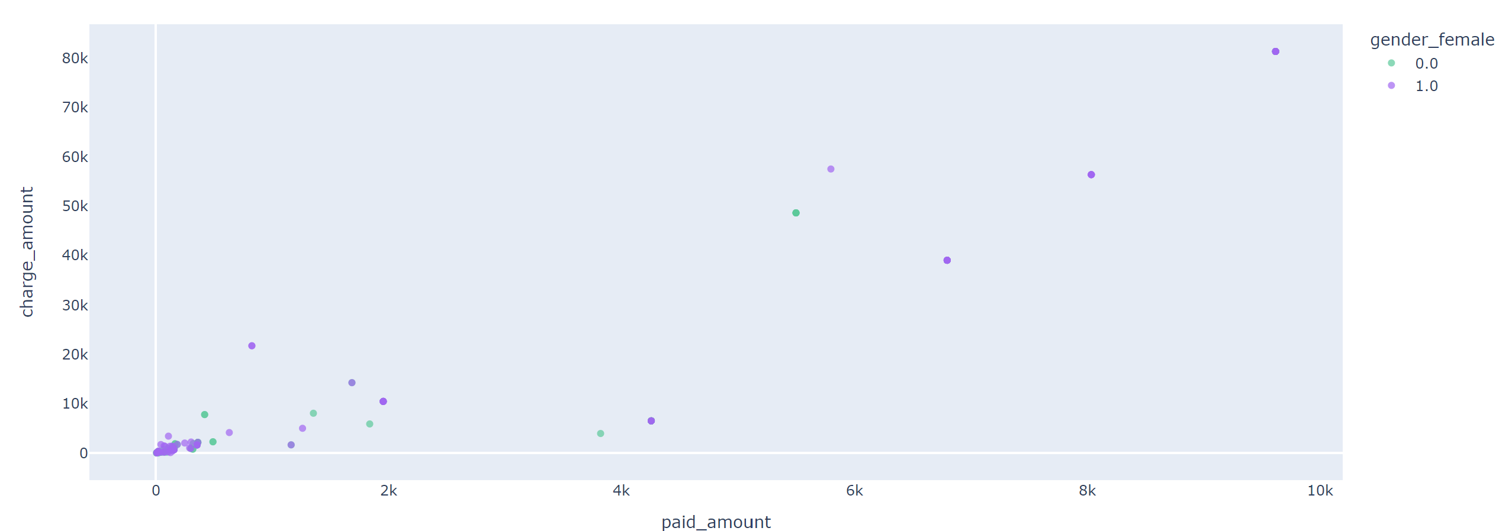
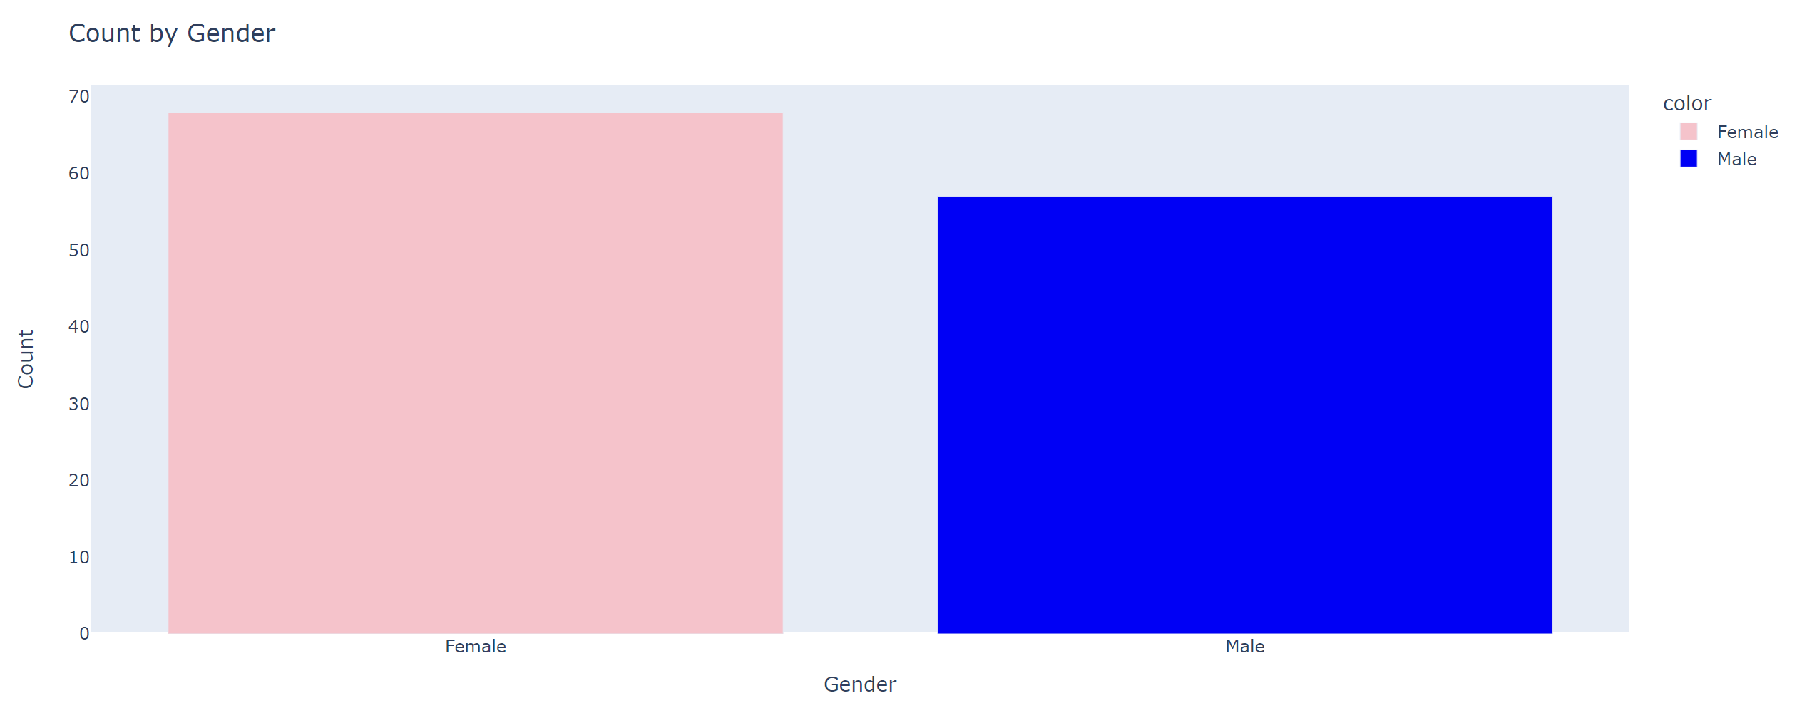
MODEL DATASET EDA
MODEL DATASET EDA
Notes:
shiv

Slide 9
17
CLASSIFICATION MODELS
MODELS
RANDOM FOREST CLASSIFIER
LOGISTIC REGRESSION
K NEAREST NEIGHBOURS
DECISION TREE
BEFORE TUNING
BEFORE TUNING
ALL 35 X VARIABLES
BEFORE TUNING BEFORE PIPELINE
AFTER TUNING
AFTER TUNING
21 BACKWARD FEATURES
BEFORE TUNING WITH PIPELINE
BEFORE TUNING – 21 BACKWARD FEATURES
BEFORE TUNING – 21 BACKWARD FEATURES
8 FORWARD FEATURES
AFTER TUNING WITH PIPELINE
AFTER TUNING – 8 FORWARD FEATURES
AFTER TUNING – 8 FORWARD FEATURES
AFTER TUNING WITH PIPELINE 21 BWD FEATURES
EFS 5 FEATURES
AFTER TUNING WITH PIPELINE 8 FWD FEATURES
Notes:
pallavi

Slide 10
FURTHER INFORMATION ABOUT MODELS USED
1
Training testing sample was hold out, however, K-fold was employed in logistic regression and before tuning for parameters. K-fold was used over grid search tuned parameters, sequential features selector and exhaustive feature selection.
3
Random forest classifiers and decision trees were deployed without feature selection and scaling. Scaling was only done for K nearest neighbors and logistic regression models
2
For logistic regression, predict and not predict_proba were used, as the former assigns class for given input and the latter estimates the confidence level for the given input. In this case, classification was required, hence predict was used.
4
Testing dataset included only two deaths
Pipeline feature was used as it avoids data leakage
Notes:
COMBINE 3 – 4
PT 7 TO PT1
5-6 COMBINED
2. predict_probo not predict probability
5 points total

Slide 11
SFS MODEL FEATURES
8
21
4
FORWARD
FEATURES
BACKWARD
FEATURES
EXHAUSTIVE
FEATURES
age
age
race_hispanic
gender_female
gender_female
race_white
race_asian
race_asian
dose_1
race_black
race_black
loinc_9279-1
race_hispanic
race_hispanic
race_northamericannative
race_northamericannative
race_white
race_white
coverage_duration
race_other
prescription_procurement_duration
active_status_1
claim_type_dme
claim_type_i
claim_type_p
paid_amount
claim_duration
coverage_duration
medicare_payer_type
dose_1
dose_prn
dose_sch
loinc_8310-5
Notes:
pallavi

Slide 12
ANALYSIS RESULTS
LOGISTIC REGRESSION
K NEAREST NEIGHBOURS
DECISION TREE
After tuning decision tree, the F1 score for training data decreased
With backward feature selection the overall fit for logistic regression model decreased
The KNN model before-tuning-with-pipeline worsened than without-pipeline for training data, as positives decreased. KNN-after-tuning works better on training testing as compared to testing data.
In decision tree model, race_white was the first split, followed by age 74 years or claim_duration 23 days
With all features the model performed best with an accuracy score of 0.95.
With both, fwd feature selection and bwd feature selection, the model performed with accuracy score of 0.86
KNN results changed for 8 forward features whereas with 21 backward features it showed no change
DT models were tuned with 8 forward x features, age as second split for white patients to survive. Compared to DT models with 35 x features, taking claim_duration into account for white patients to survive.
With backward feature selection logistic model performed worse, whereas KNN model performed better
In KNN with pipeline and after tuning on both 35 features and 21 features, the false positives decreased with lesser features
Notes:
pallavi

Slide 13
2
MODELS CHOSEN
MODELS
01
02
03
Testing data
Accuracy score: 0.87
Precision score: 0.2
Recall score: 0.5
F1 score: 0.29
Training data
Accuracy score: 0.93
Precision score: 0.7
Recall score: 0.7
F1 score: 0.7
First split is at race_white and second split is at age. the total depth of The tree is 3.
RFC TUNED & 8 FWD FEATURES
DECISION TREE TUNED WITH 8 FORWARD FEATURES
(varies across features)
01
02
03
Hyperparameters used are N Estimators =155
Testing data
Accuracy score: 0.87
Precision score: 0.2
Recall score: 0.5
F1 score: 0.29
Training data
Accuracy score: 1.0
Precision score: 1.0
Recall score: 1.0
F1 score: 1.0
Notes:
shiv

Slide 14
CONFUSION MATRICES
RFC
DECISION
TREE
TESTING DATA
TESTING DATA
 | pred: 0 | pred: 1
Actual: 0 | 32 | 4
Actual: 1 | 1 | 1
 | pred: 0 | pred: 1
Actual: 0 | 32 | 4
Actual: 1 | 1 | 1
TRAINING DATA
TRAINING DATA
 | pred: 0 | pred: 1
Actual: 0 | 77 | 0
Actual: 1 | 0 | 10
 | pred: 0 | pred: 1
Actual: 0 | 74 | 3
Actual: 1 | 3 | 7
Notes:
shiv

Slide 15
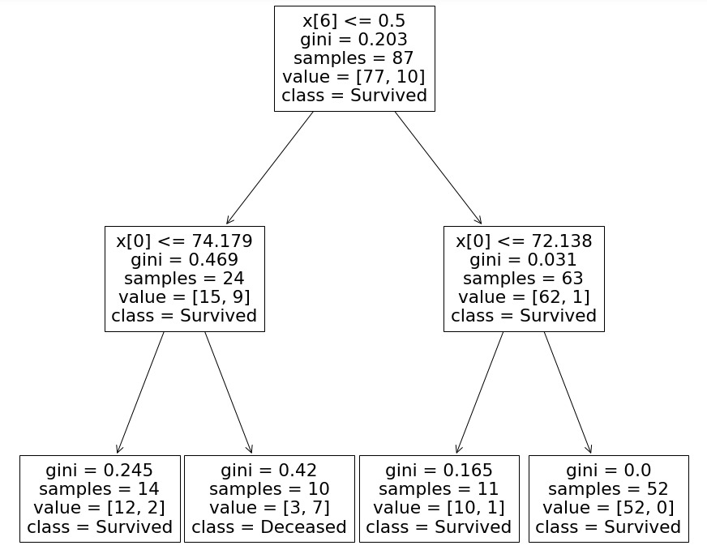
DECISION TREE
Characteristics of Survived (1)
Not white, x[6] <= 0.5
Age, x[0] > 74 years
Characteristics of Survived (2)
White, x[6] >= 0.5
Age, x[0] > 72
Age, x[0] < 72
Characteristics of Deceased
Not white, x[6] <= 0.5
Age, x[0] < 74 years
Notes:
Moeez
Race matter a lot, non white people don’t have much access to care, if white usually survive

Slide 16
WHY PREDICTIVE ANALYTICS? NS
Encompasses a wide range of approaches, including the use of machine learning and predictive analytics like k-means clustering, logistic regression, decision-tree and other models.
Can find similar attributes in patients, clustering them to monitor their clinical history data, and predict the likelihood of potential health problems
Can be used to take proactive measures against certain illnesses or diseases
THE WAY FORWARD
Notes:
shingi

Slide 17
- THANK YOU -
Notes:
Photo by rawpixel on Unsplash
shingi

